Slide 1
LWPsix

Slide 2
Project Description
Inspired by LWP for Perl 5…
High-level implementation of HTTP
Common web use cases simply and straightforwardly
Subclassers provide complex behavior

Slide 3
Core Features
GET requests
Support for HTTP/1.0
Support for HTTPS and HTTP proxies
Cookie handling
Basic and Digest authentication

Slide 4
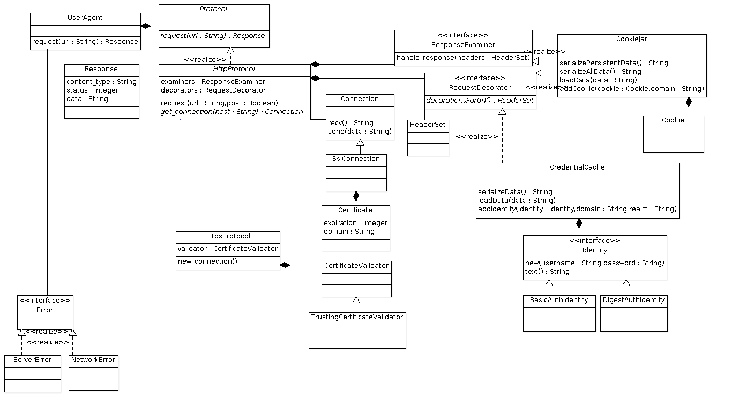
Project Design

Slide 5
Division of Labor
Basic overall library organization & HTTP
Richard
Headers
Dom
HTTPS/SSL
Mel

Slide 6
Timeline
22-Mar : Unit Tests for modules
Assume full functionality of (& mock out) dependencies
2-Apr : Complete Perl 6 handbook, examples
6-Apr : Demo specs sent to JJ for approval
13-Apr : Complete individual modules
20-Apr : Complete integration
26-Apr : Complete demo
7-8 May : Demo day
9 May : Final demo

